Slide 1
Reinforcement Learning Part 1

Slide 2
Outline
Introduction to reinforcement learning
Summary
Applications
Types
Foundations of reinforcement learning
State-action space
Markov chains
Exploration v Exploitation
Demos
Grid world
Cart pole
Proc gen

Slide 3
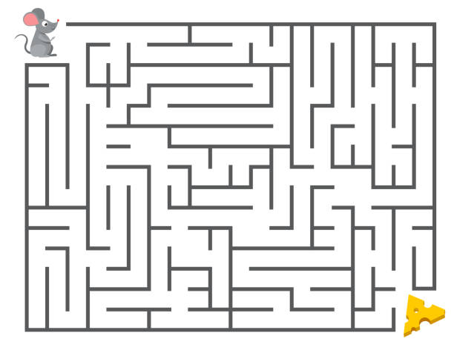
Introduction to Reinforcement Learning
Machine learning
Supervised Learning
Unsupervised Learning
Reinforcement Learning
Training of models/agents to make a sequence of decisions
how intelligent agents ought to take actions in an environment in order to maximize the notion of cumulative reward

Slide 4
Applications
Robotics
Self driving cars
Games: AlphaGo, Atari (https://youtu.be/mqma6GpM7vM?t=174)
Decision making in Healthcare, engineering, finance etc.

Slide 5
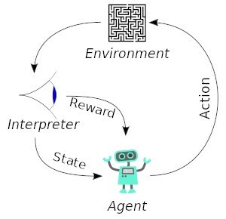
Common Terms
State space: Description of the situation an agent is in
Action space: Set of all available actions an agent can take in a given state
Reward: Incentive for reaching a particular state
Policy: A rule or principle that helps determine the best set of actions in a given state
Agent: entity that navigates and observes states, learns and performs the actions and obtain the rewards
Types of reinforcement learning environments:
Deterministic: No uncertainty involved: solving a maze
Random: Uncertainty plays a role: poker
Simple: small state space: tic-tac-toe
Complex: large state space: video games
Notes:
https://medium.com/swlh/states-observation-and-action-spaces-in-reinforcement-learning-569a30a8d2a1

Slide 6

Markov Chain (DEMO)
DEMO
$P\left(Next state\right| Present and all Past States)=P \left(Next State \right|Present State)$
Probability of weather being sunny tomorrow, given that it is sunny today = 0.5
Can we simulate the weather for the next 50 days?
Next
0.15
0.65
 | Sunny | Cloudy | Rainy
Sunny | 0.5 | 0.5 | 0
Cloudy | 0.25 | 0.5 | 0.25
Rainy | 0.65 | 0.20 | 0.15
Sunny
Rainy
0.5
Now
0.25
Cloudy
0.25
0.5
0.20
0.5

Slide 7
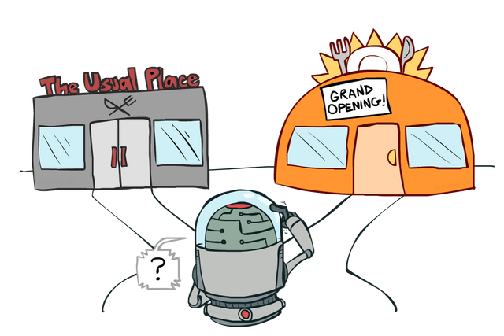
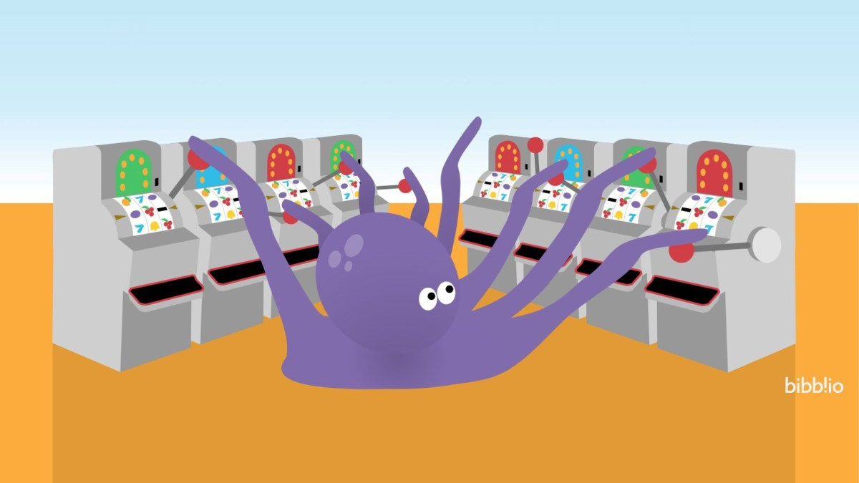
Exploration vs Exploitation
DEMO
Common dilemma faced by learning agents:
Explore: whether to explore new strategies, or
Exploit: exploit learned knowledge
Multi Armed Bandit
Multiple slot machines (bandits) whose reward distribution is unknown
Objective is to maximize the rewards in a limited number of trials (say 100)
What policy will you use to pull?
Exploit: keep pulling the lever which has high reward?
Explore: Try random sampling?
Notes:
https://lilianweng.github.io/lil-log/2018/01/23/the-multi-armed-bandit-problem-and-its-solutions.html

Slide 8
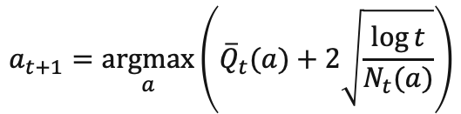
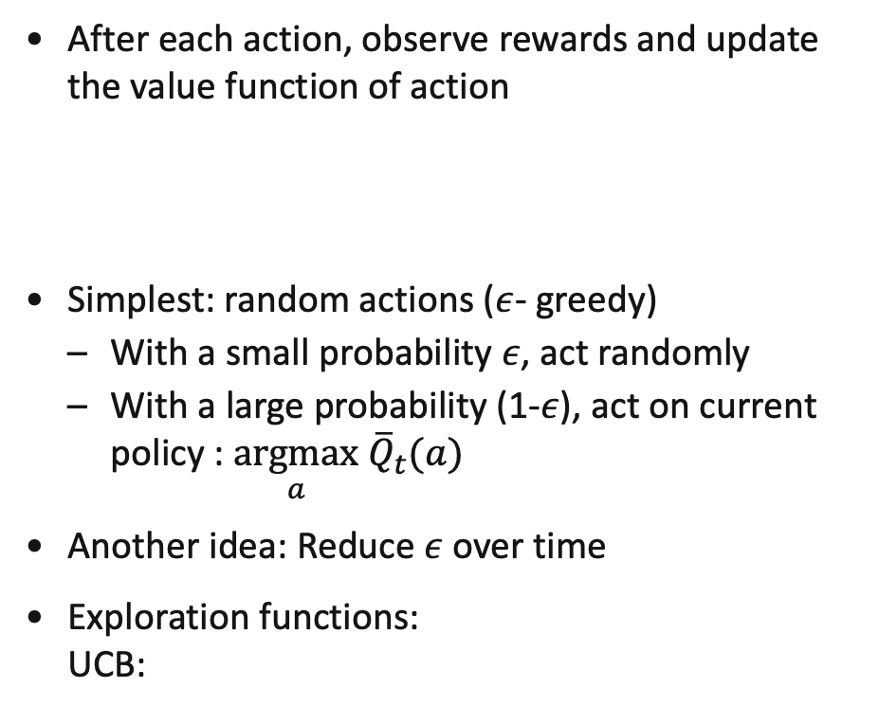

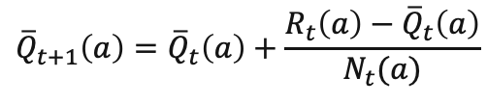
Exploration v Exploitation
After each action, observe rewards and update the value function of action
Simplest: random actions ($ε$- greedy)
With a small probability $ε$, act randomly
With a large probability (1-$ε$), act on current policy : $\underset{a}{argmax}$ ${\overline{Q}}_{t}(a)$
Another idea: Reduce $ε$ over time
Exploration functions: UCB:
$${\overline{Q}}_{t+1}\left(a\right)={\overline{Q}}_{t}\left(a\right)+\frac{R_{t}\left(a\right)−{\overline{Q}}_{t}\left(a\right)}{N_{t}(a)}$$
Average reward by taking action $a$
$$a_{t+1}=\underset{a}{argmax}\left({\overline{Q}}_{t}(a)+2\sqrt{\frac{\log{t}}{N_{t}(a)}}\right)$$

Slide 9
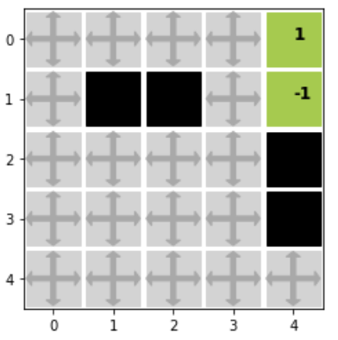
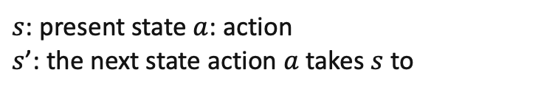
GridWorld
DEMO
States: Cell positions/labels
Action: Left, Right, Up, or Down
Reward: 1 for safe destination, -1 for danger
Destination
Danger
Value Function:
Function defined on the state space [V(s)]
Tells how valuable the state is for an agent to be in
Objective is to determine the optimum value function
Obstacles
Value Iteration:
Dynamic program to determine the optimal value function
Works well for small state-action space
$$V\left(s\right)=\max_{a}\left(R\left(s,a\right)+γV\left(s^{′}\right) \right)$$
$s$: present state $a$: action $s$’: the next state action $a$ takes $s$ to

Slide 10
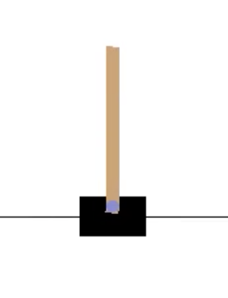
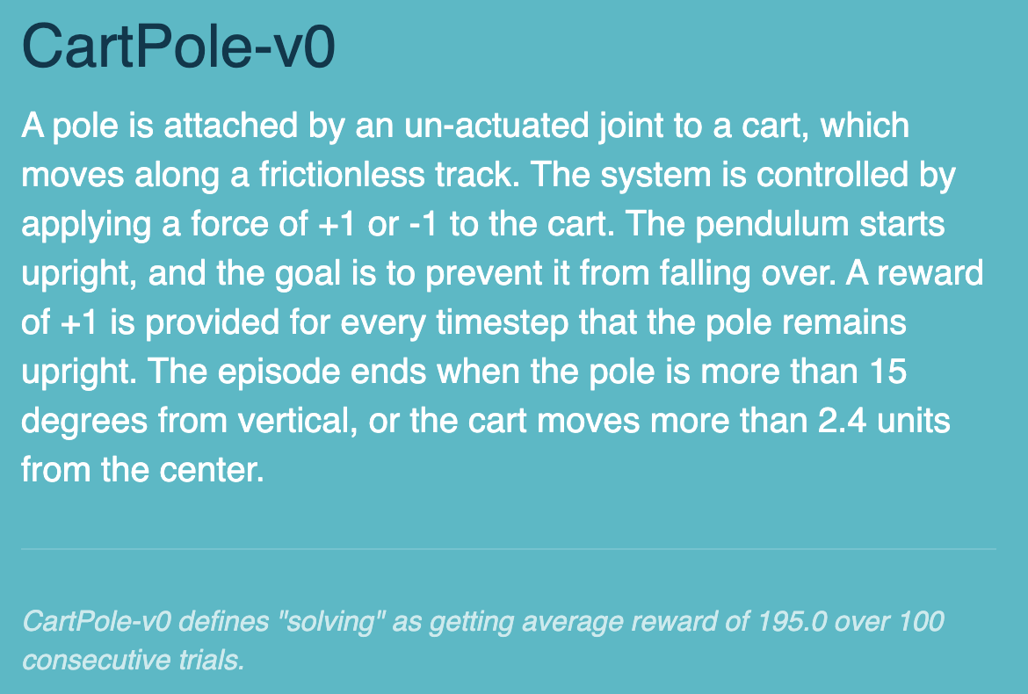
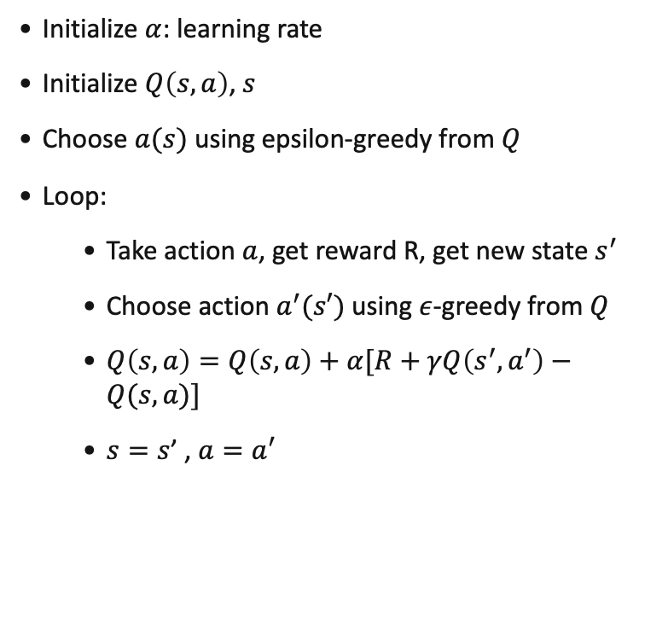
Cartpole
DEMO
SARSA (State- Action- Reward ..) Algorithm
Initialize $α$: learning rate
Initialize $Q\left(s,a\right)$, $s$
Choose $a(s)$ using epsilon-greedy from $Q$
Loop:
Take action $a$, get reward R, get new state $s^{′}$
Choose action $a^{′}(s′)$ using $ε$-greedy from $Q$
$Q\left(s,a\right)=Q\left(s,a\right)+α[R+γQ\left(s^{′},a^{′}\right)−Q(s,a)]$
$s=s$’ , ${a=a}^{′}$
States: [cart x position, cart velocity, pole angle, pole velocity] infinite state space
Action: Force of 1 to the left (-1) or right (+1)
Reward: +1 for every timestep the pole is upright

